Slide 1
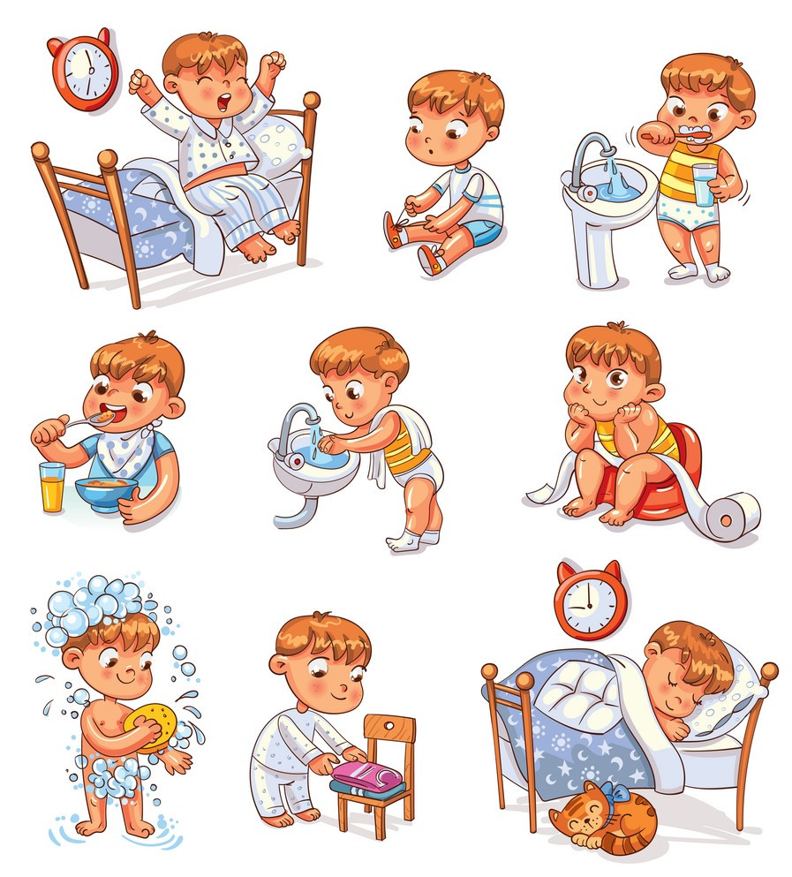
Grade 4
UNIT 6
Jim’s day
Lesson 2

Slide 2
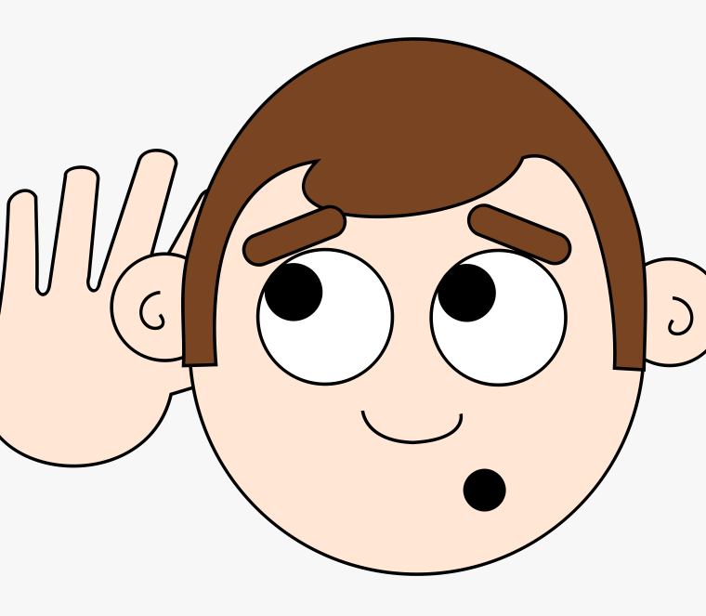
LISTEN and REPEAT

Slide 4
Read and circle
1. Vinh get / gets up at six o'clock. 3. Do / Does she have a shower at night? 5. He doesn't / don't walk to school. | 2. I has / have breakfast with my family. 4. They doesn't / don't catch the bus to work. 6. Do / Does they brush their teeth at night?

Slide 5
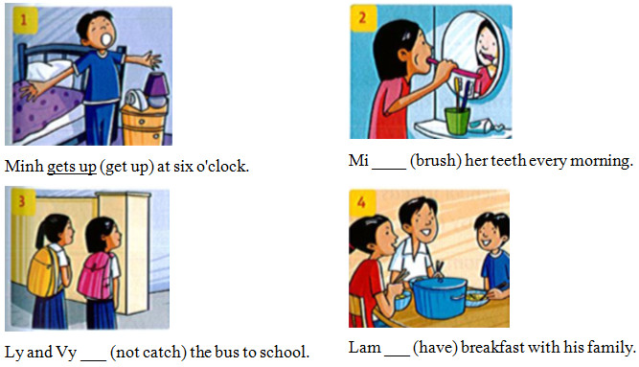
WRITE
brushes
doesn’t catch
has

Slide 6
Workbook time!!!

